Slide 1

Live Free
By Elizabeth Woodson
Bible Study On The Book of Galatians

Slide 2

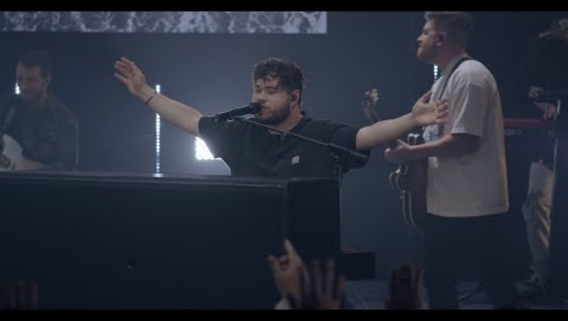
Praise And Worship
Lift uP Holy Hands

Slide 3
prayer
Let’s Approach His Altar Boldy

Slide 4
Hi My Name Is
Name
Favorite worship song and why?
WELCOME!

Slide 5
Praise Him!
Praise Him
Praise the LORD that He is
Praise the LORD for who He is
Praise God for what He has done
Praise the LORD for what He is doing

Slide 6



Video #1 -
Introduction
You can take notes on pages 20-21

Slide 7
Discussion Questions
What drew you to studying the book of Galatians?
What’s one thing Elizabeth said that stuck with you from the video?
Elizabeth described why Paul wrote Galatians, speaking to the cultural context of the book. How do you see the same needs in the modern church? In your own life?
Give a quick summary of the key themes for the book of Galatians, which Elizabeth described during the video. Which of these themes stands out to you as something you’re curious to learn more about?

Slide 8
Next Time
Read
Galatians 1
Observe
What is the passage saying?
Interpretation
How will you walk this passage out?
Reflection
Key words, phrases, theme(s)
If you do not have the book, at least read the scripture and observe what is going on and reflect on what the passage is saying to you.

Slide 9
Thank you
Tracy Hawkins
lifehiswayministry@gmail.com
www.lifehiswayministry.com

