Slide 1

Live Free
By Elizabeth Woodson
Bible Study On The Book of Galatians
Notes:
Ask participants to share which day of study they found most
interesting and which one had the most impact on them

Slide 2

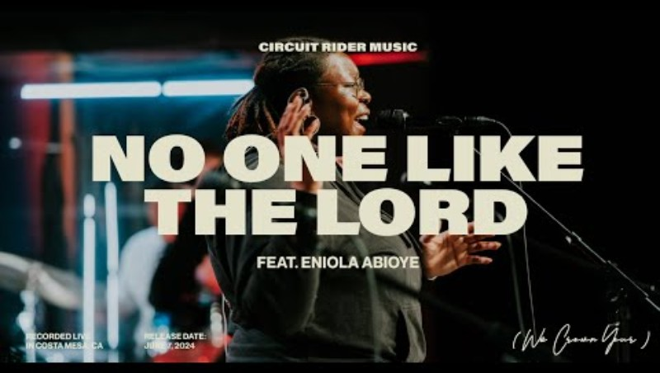
Praise And Worship
Lift uP Holy Hands

Slide 3
prayer
Let’s Approach His Altar Boldy

Slide 4
Praise Him!
Praise Him
Praise the LORD that He is
Praise the LORD for who He is
Praise God for what He has done
Praise the LORD for what He is doing

Slide 5

Bible Timeline
The Story of The Bible
Notes:
Page 12-13
Creation – Genesis 1-2
Fall – Genesis 3
Anticipation - Genesis 4-50 – Malichi
Redemption – Matthew – Jude
Restoration – Revelation

Slide 6
RECAP – The Two Doors
Counterfeit Way
Disappointment
Discouragement
False gospel to enslave us
His Way
Driven by love and hope
Freedom from sin
Freedom to do what we were designed to do

Slide 7
Galatians
Paul, formerly Saul is the author
Acts 8 & 9 and Philippians
Written early on in his missionary journeys.
The church of Galatia is the audience. It would be read aloud in one setting.
The main point of Galatians was to warn against the false gospel that was being taught. Adding to salvation message. Adding circumcision and dietary law to be truly saved.
Themes: False gospel – Jesus + something else
Jewish religious practices & the Law
Family of God
Freedom in God

Slide 8

clear
Notes:
Remind your group that Elizabeth intentionally leaves some questions
unresolved to encourage personal study and engagement with God’s
Word. What questions do you have after this week’s study?
Ask a few women to share the summary statements they came up with
for the main idea of Galatians (p. 24)
Did you notice how you had to flip to pages that were ahead in the book…..

Slide 9
Discussion Questions
READ GALATIANS 1 ALOUD.
1. Read Ephesians 2:1-5. How does this passage help you understand why Paul says we needed to be rescued (1:4)?
REFLECT & RESPOND: Look back to Paul’s description of God the Father and Jesus Christ in 1:1-4. What are some practical ways you can glorify God for His gracious gift? Give one or two examples.
2. How does comparing 1:7 in the CSB and NIV help you understand the impact of the “different gospels” the Galatian Christians encountered?
REFLECT & RESPOND: What are some examples of “different gospels” that are being taught today, either from church pulpits or online?
What is the danger of believing these modern-day false gospels? How can we be more discerning about the spiritual information we hear in these spaces?

Slide 10
Discussion Cont’d
3. What was the goal of God’s work in Paul’s life?
REFLECT & RESPOND: What tends to make us believe that our past actions can prevent God from using us for ministry? In these moments, how can Paul’s testimony encourage us?
4. How does the Judean church respond to reports about Paul’s ministry (1:22-24)? In light of Paul’s life before Christ, why is their response significant?
After his conversion, Paul spends many years in solitude with God, learning gospel truth from Him. Why do we as believers need to spend time in silence and solitude with God? What obstacles prevent us from regularly practicing this spiritual habit? Which do you struggle with most?

Slide 11



Video #2 -
You can take notes on pages 43

Slide 12
Next Time
Read
Galatians 2
Observe
What is the passage saying?
Interpretation
How will you walk this passage out?
Reflection
Key words, phrases, theme(s)
If you do not have the book, at least read the scripture and observe what is going on and reflect on what the passage is saying to you.

Slide 13
Thank you
Tracy Hawkins
lifehiswayministry@gmail.com
www.lifehiswayministry.com

Slide 14
Hi My Name Is
Name
Favorite worship song and why?
WELCOME!

